Slide 1





Teacher’s slide
Key lesson information
Location | Classroom with computer and internet access
Recommended time | 15 minutes
Objectives | By the end of the session, students should be able to: Identify at least one career of interest to them, after browsing the Careers library Add at least one career profile to their Favourites
Main student tasks | Learn how to use the Careers library tool Use the Careers library tool to browse career profiles using at least one search criteria
Keywords | Careers, Careers library, jobs, employment
Know-how library
Open the ‘student side’ of your Unifrog account and click these links: ‘How to… use the Careers library’ ‘Careers: Key terms’ Students can also search for these guides using the Know-how library tool.
Tracking progress on Unifrog
Add as an Interaction | Click Advanced view>Sort by school leaving year>[filter for specific students]>+interaction.
Track on Charts | Click Usage charts>Customise and filter to track most popular career profiles
Tracking individual students | Advanced view>Sort by>Library profiles in Favourites
Benchmarks and standards
Gatsby Benchmarks | 2. Learning from careers and labour market information 3. Addressing the needs of each student 4. Linking curriculum to careers
CDI Framework | Explore possibilities
PSHE Association | Choices and pathways, Work and career
CASEL 5 | Self-management
ISCA | C:A2:3; C:B1:1
Skills | Planning / aiming high
Teacher preparation
Provide | Computer and internet access
Familiarise yourself | Open the ‘student side’ of your Unifrog account and click this link: Careers library

Slide 2

Quick task: Exploring the Careers library

Slide 3

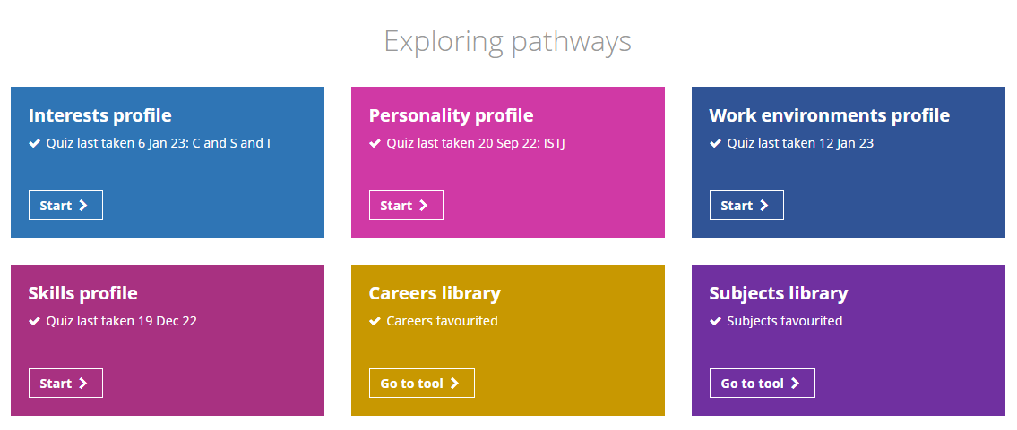

Using the Unifrog Careers library
The next few slides will show you how to use the Careers library tool.
After logging into your Unifrog account, scroll down to ‘Exploring pathways.’
Click ‘Go to tool’ on the Careers library.
Notes:
Teacher’s notes:
The next few slides will teach students how to navigate the platform to use the Careers library tool.
Ask students to log into their Unifrog accounts and open the Careers library tool. You can demonstrate this on a smart board by clicking Student side>Careers library.

Slide 4

Using the Unifrog Careers library
You can search the Careers library by:
Keyword, e.g. Computers
Subject group, e.g. Animals
School subjects, e.g. Biology
Theme, e.g. Green jobs
Career sectors, e.g. Transport
Personality type, e.g. INTJ
Career area, e.g. Arts and Media
Interests, e.g. Artistic
Skill, e.g. Accountability
Work environments, e.g. No long hours
Notes:
Teacher’s notes:
The next few slides will teach students how to navigate the platform to use the Careers library.
Students can search the Careers library in numerous ways:
Keyword – students type in a keyword, such as Computers and click ‘Go’.
School subjects – students select up to three of their favourite current school subjects from the drop-down lists and click ‘Go’.
Career sectors – students click ‘See all Sectors’ and then ‘Read the profile’ for a relevant sector. When viewing a career sector profile, students can scroll down to ‘Careers in this sector’ and then click the links to read related career profiles.
Students can also browse the Careers library via clicking the categories listed under:
Career area, skill, subject group, theme, personality type, interests, and work environments.

Slide 5
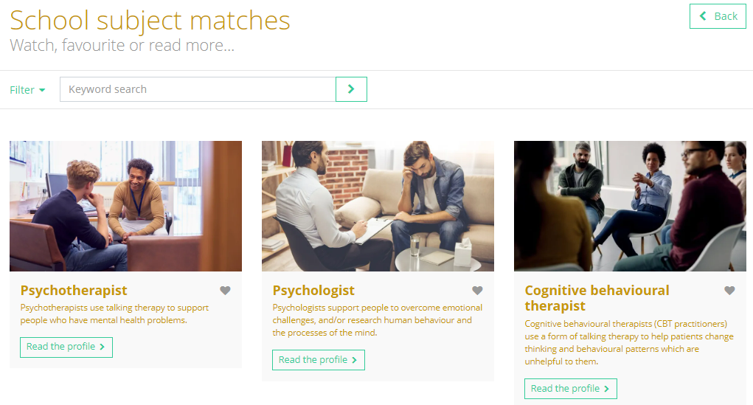
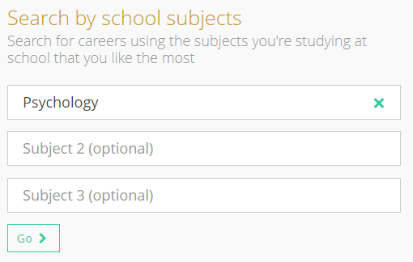

Using the Unifrog Careers library
You will then will see career profiles that are matches for your search.
Psychology as a school subject has been used as an example here:
Notes:
Teacher’s notes:
The next few slides will teach students how to navigate the platform to use the Careers library.
Students will see a list of career profiles that match their chosen search criteria, such as school subject.
Students can use the ‘Filter’ button to narrow down their results by career area, subject area, prospects, education requirements, and level of match (depending on the search criteria used).
From this page, students can add career profiles to their Favourites by clicking the heart symbol and/or read the career profiles by clicking ‘Read the guide’.
Next time students visit the Careers library, their favourite career profiles will appear at the top of the page.
Students can also access their favourite career profiles by clicking ‘Favourites’ at the top of the screen, then ‘Library tools,’ and ‘Filter by Career.’

Slide 6


Using the Unifrog Careers library
Click ‘Read the profile’ to find out more.
Click the heart button to add the profile to your Favourites.
Return to your search results at any time by clicking ‘Back’ on the career profile.
Notes:
Teacher’s notes:
The next few slides will teach students how to navigate the platform to use the Careers library.
Students will see a list of career profiles that match their chosen search criteria, such as school subject.
Students can use the ‘Filter’ button to narrow down their results by career area, subject area, prospects, education requirements, and level of match (depending on the search criteria used).
From this page, students can add career profiles to their Favourites by clicking the heart symbol and/or read the career profiles by clicking ‘Read the guide’.
Next time students visit the Careers library, their favourite career profiles will appear at the top of the page.
Students can also access their favourite career profiles by clicking ‘Favourites’ at the top of the screen, then ‘Library tools,’ and ‘Filter by Career.’
Tracking students’ progress:
You can track student progress with favouriting career profiles by clicking Advanced>Sort by>Library profiles in Favourites.
From your homepage, you can also create charts showing the range of careers that have been favourited. Go to Usage charts you can customise>Most popular career profiles.

Slide 7
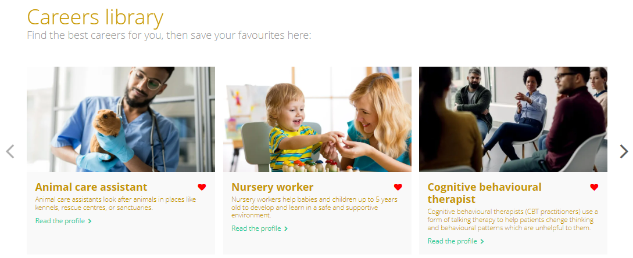
Using the Unifrog Careers library
Next time you visit the Careers library, you will see your favourite career profiles at the top of the page, so you can find them again easily.
You can also find them by clicking ‘Favourites’ at the top of your screen, then ‘Library tools.’
Notes:
Teacher’s notes:
The next few slides will teach students how to navigate the platform to use the Careers library.
Students can add career profiles to their Favourites by clicking the heart symbol.
Next time students visit the Careers library, their favourite career profiles will appear at the top of the page.
Students can also access their favourite career profiles by clicking ‘Favourites’ at the top of the screen, then ‘Library tools,’ and ‘Filter by Career.’
Tracking students’ progress:
You can track student progress with favouriting career profiles by clicking Advanced>Sort by>Library profiles in Favourites.
From your homepage, you can also create charts showing the range of careers that have been favourited. Go to Usage charts you can customise>Most popular career profiles.

Slide 8

Exploring the Careers library
Now it’s your turn to explore careers!
If you’re unsure where to start, search by school subjects and select up to three of your favourite subjects that you’re currently studying.
Remember to click the heart button to add a career profile to your Favourites.
Notes:
Teacher’s notes:
Following the instructions in the last few slides, students will be able to browse the Careers library. (Student side>Careers library)
When students are viewing a career profile, they will be able to read:
What you’ll do
Working hours and environment
Career path and progression
Skills required
Entry requirements
Related university subject profiles
Related career profiles
Relevant education and training opportunities available (Explore section)
Labour Market Information (LMI)
Tracking students’ progress:
You can track student progress with favouriting career profiles by clicking Advanced>Sort by>Library profiles in Favourites.
From your homepage, you can also create charts showing the range of careers that have been favourited. Go to Usage charts you can customise>Most popular career profiles.

Slide 9


