Slide 1
Every Subject Teacher is a Careers Teacher?
The Norwood School
Claire Nix & Trevor Bottomley

Slide 2
Objectives
To help embed career learning within subjects.
Provide departments with resources to do this.
To share ideas and record best practice for supporting our students’ employability and career progression.

Slide 3
Our Roles as Teachers
Can share information with pupils about their own career pathways and choices
Tutors already offer initial information and advice on option choices and can help identify guidance needs and along with HOY refer pupils to careers advisers
Subject teachers can help pupils relate their subject to the workplace (skills & knowledge), explain the progression opportunities from their subject and contribute to careers education through cross-curricular work/projects/enrichment

Slide 4
Reasons to embed careers
Subject staff can make a valuable contribution to helping students make the right choices.
Improves aspirations and achievement.
Supports take-up and retention rates.
Enriches teaching and learning.
Strengthens partnerships and collaboration.
Helps students appreciate the skills subjects develop for life.
Raises the profile of the subject.
Supports innovation. And fresh approaches.
Helps parents and students value the subject.

Slide 5
Making the case….!
Britain has lower levels of social mobility than most other comparable countries…ours is a country where the class and income of children when they grow up is more related to the class and income of their parents than elsewhere (Social Mobility and Child Poverty Commission, 2015)
Guidance is important for Social Mobility because it helps open pupils’ eyes to careers they may not have considered’ (Gatsby report 2014)
‘Where schools and colleges do meet a high standard in the advice and guidance they offer, there are some dividends in improved attendance, better GCSE results and wiser university choice’ (Advancing Ambitions – Sutton Trust 2014)
By being exposed to four or more employers, school leavers are up to 20% less likely to be NEET, earn 18% more when in full-time work and develop a much higher level of confidence (CIPD, 2013)

Slide 6
Compass - Areas for Potential Improvement
Publishing your career programme on your website
Evaluating the effectiveness of your careers programme at least every three years
Addressing the needs of each pupil
Keeping systematic records on each pupils' experiences of career and enterprise activity
Enabling pupils to have access to accurate records about their own careers and enterprise experiences
Collecting and maintaining accurate data for each pupil on their destinations for 3 years after they leave your school
Ensuring students have experienced career learning as part of English, Maths and Science.
Ensuring the overwhelming majority of students have at least one meaningful encounter with an employer every year of school.
Ensuring all / the overwhelming majority of students have had at least two interviews with a professional careers adviser by the end of Year 13

Slide 7
In faculty pairs/small groups
Consider ways in which your faculty already offer various kinds of careers guidance in lessons and as extra curricular enrichment.
How and when do you explain the progression opportunities from your subject and the qualifications gained?
Do you have any links with colleges or employers in your faculty?

Slide 8
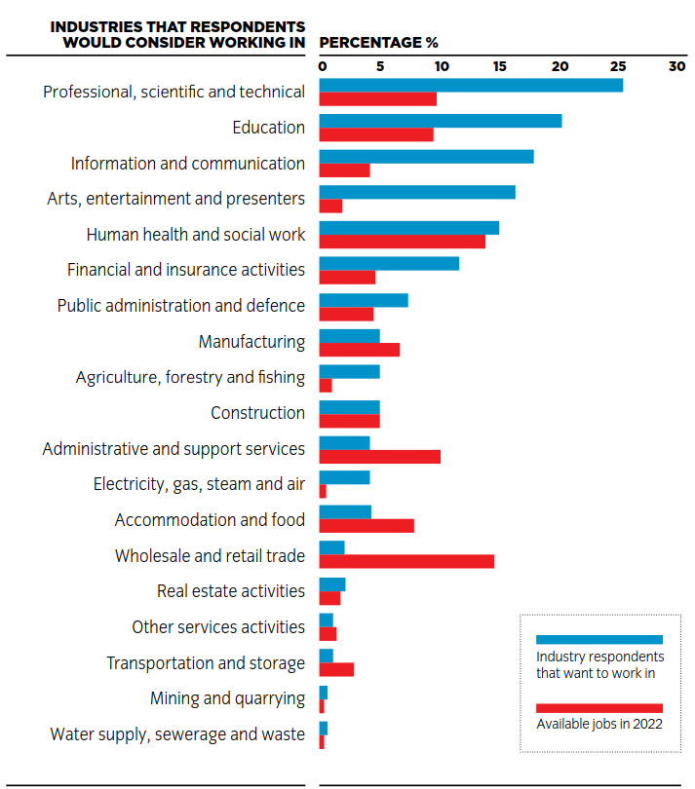
Great Expectations
City & Guilds report into teenagers’ career aspirations v reality of the jobs market
Young people opting for jobs with limited employment options
Have unrealistic salary expectations and misunderstand entry routes
Report calls for better job market and destinations information

Slide 9

Confidence Levels
According to YouGov survey 80% of teachers wished they knew more about the options available to their students

Slide 10
Task
Spend some time looking at some of the resources available to develop careers provision in the curriculum.
Are there particular progression issues within your faculty?
Break away into faculties to computers

Slide 11












Getting to grips with resources

Slide 12
Links
Question | Possible Link
Top ten Maths careers sites? | www.cegnet.co.uk/uploads/resources/Careers_using_maths.pdf
Experiencing the world of STEM careers? | www.stem.org.uk www.futuremorph.org/teachers
Finding a STEM ambassador – careers talks, speed dating, clubs, classroom activities? | www.stem.org.uk/stem-ambassador-hub-london/teachers www.tunnelworks.co.uk
Get in touch with employers? | https://londonambitionsportal.london.gov.uk
Information about apprenticeships? | www.getingofar.gov.uk
Film content about different careers? | http://icould.com www.careersbox.co.uk
Careers linked to school subjects? | https://successatschool.org/advice/subjects www.aimhigherwm.ac.uk/images/files/where-can-science-take-me-booklet.pdf
HE outreach events & resources? | www.heinlondon.ac.uk
Materials to support employability? | www.barclayslifeskills.com www.tunnelworks.co.uk/skills.php
Digital skills resources? | www.barclayslifeskills.com/teachers/support/digital-tools-for-educators
Job profiles and further information about job areas? | https://nationalcareersservice.direct.gov.uk/job-profiles/home
Film content about skills in the workplace? | www.worldskillsuk.org/the-skills-show

Slide 13
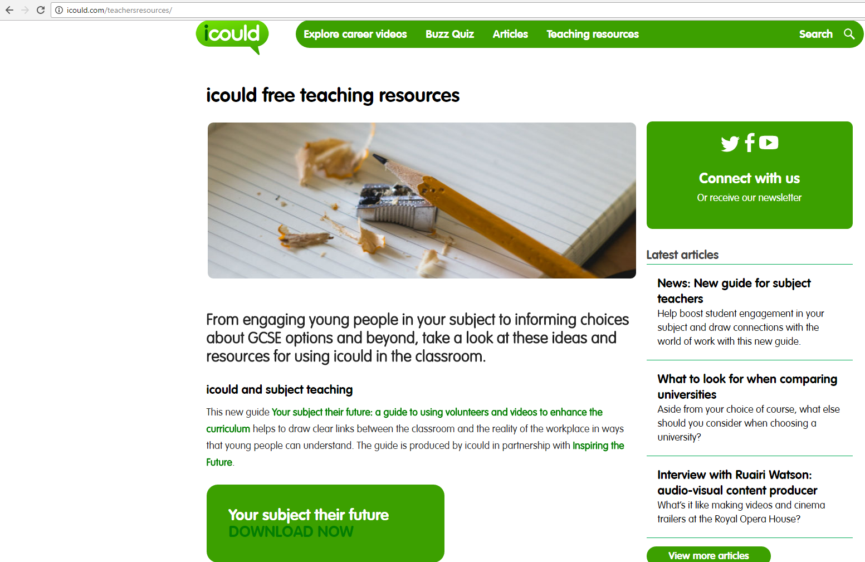

Slide 15
Faculty Areas
English
Maths
Science
Modern Foreign Languages
Performing Arts
Visual Arts
PE/Wellbeing/Sport/Health and Social Care
IT/Business Studies/psychology
Humanities - RS/Philosophy/Geography /History/Sociology
Cross curricular developments such as the Big Draw which brings together Science, Technology, Art and Maths, Fair Trade Fortnight, Earth Day

Slide 16

English
Jobs with ...
  https://successatschool.org/advice/subjects
  https://www.prospects.ac.uk/careers-advice/what-can-i-do-with-my-degree/english
  https://nationalcareersservice.direct.gov.uk/job-profiles/marketing-selling-and-advertising
  https://nationalcareersservice.direct.gov.uk/job-profiles/education-and-training
Videos (Could list every job, these are examples)...
  http://icould.com/stories/subject/english/
  http://tv.careersbox.co.uk/sector.php?sector=42
Curriculum projects/role models
  www.skyacademy.com/building-skills

Slide 17

Maths
Resources ...
  www.stem.org.uk
  www.futuremorph.org/teachers
  https://www.stem.org.uk/stem-ambassador-hub-london (2,500 volunteers)
  http://www.tunnelworks.co.uk/
  http://www.tomorrowsengineers.org.uk/ (Energy Quest half day workshop, Carbon capture activity, careers resources)
www.cegnet.co.uk/uploads/resources/Careers_using_maths.pdf (top ten Maths careers sites)
Jobs with ...
  https://nationalcareersservice.direct.gov.uk/job-profiles/financial-services
  https://successatschool.org/careerzonesummary/19/Banking-Finance
  https://www.prospects.ac.uk/careers-advice/what-can-i-do-with-my-degree/mathematics
  https://successatschool.org/advice/subjects
Videos (Could list every job, these are examples)...
  http://icould.com/stories/subject/maths/
  http://tv.careersbox.co.uk/sector.php?sector=45

Slide 18



Science
Resources ...
  www.stem.org.uk
  www.futuremorph.org/teachers
  https://www.stem.org.uk/stem-ambassador-hub-london (2,500 volunteers)
  http://www.tunnelworks.co.uk/
  http://www.tomorrowsengineers.org.uk/ (Energy Quest half day workshop, Carbon capture activity, careers resources)
Jobs with ...
  https://www.prospects.ac.uk/careers-advice/what-can-i-do-with-my-degree
  https://nationalcareersservice.direct.gov.uk/job-profiles/science-and-research
  https://nationalcareersservice.direct.gov.uk/job-profiles/manufacturing-and-engineering
  https://successatschool.org/advice/subjects
Videos ...
  http://icould.com/stories/subject/science-curriculum/
  http://tv.careersbox.co.uk/sector.php?sector=47

Slide 19
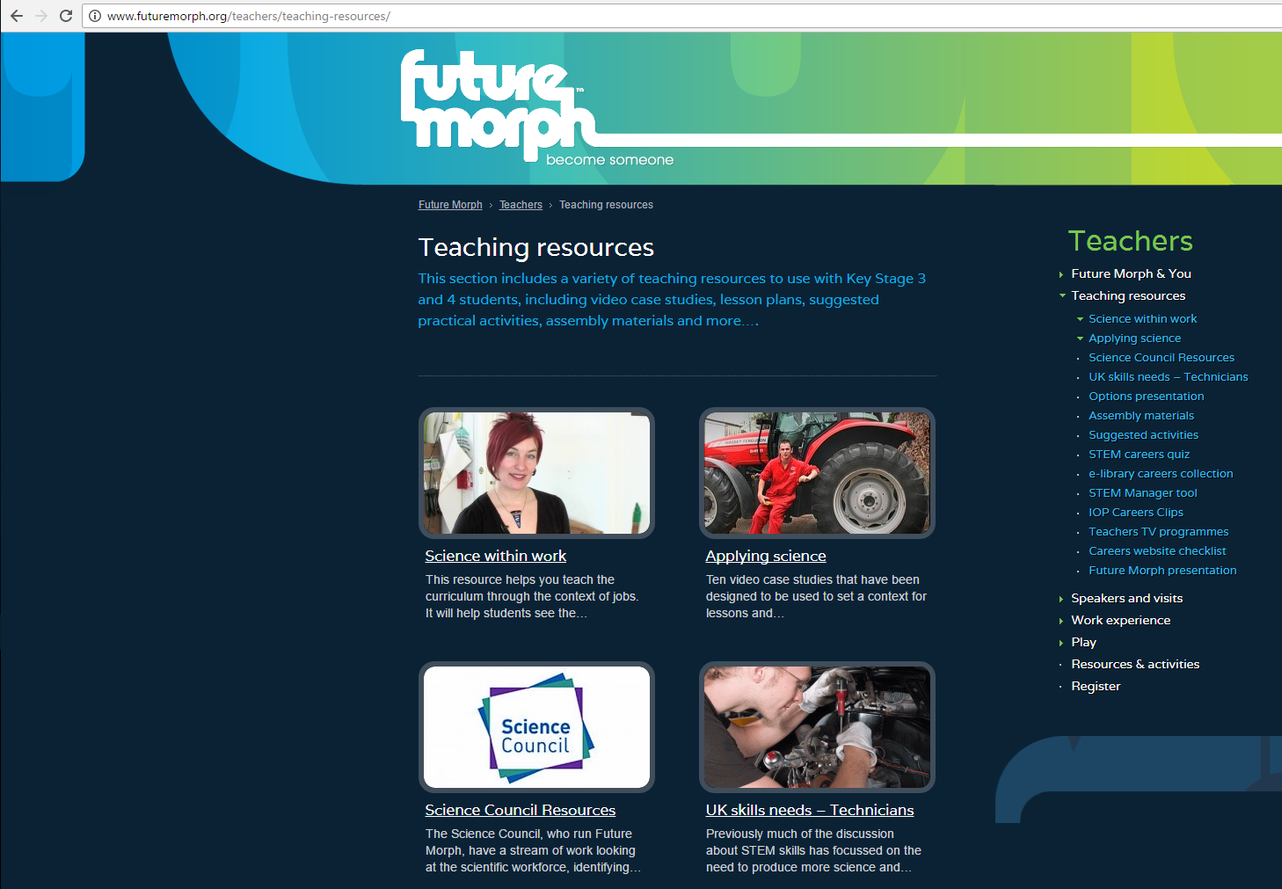

Slide 20
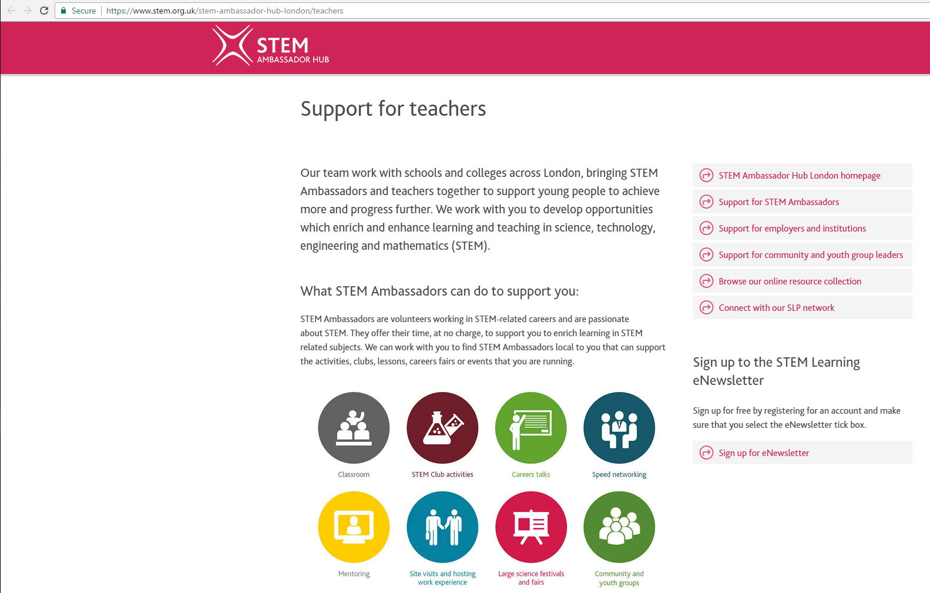

Slide 21
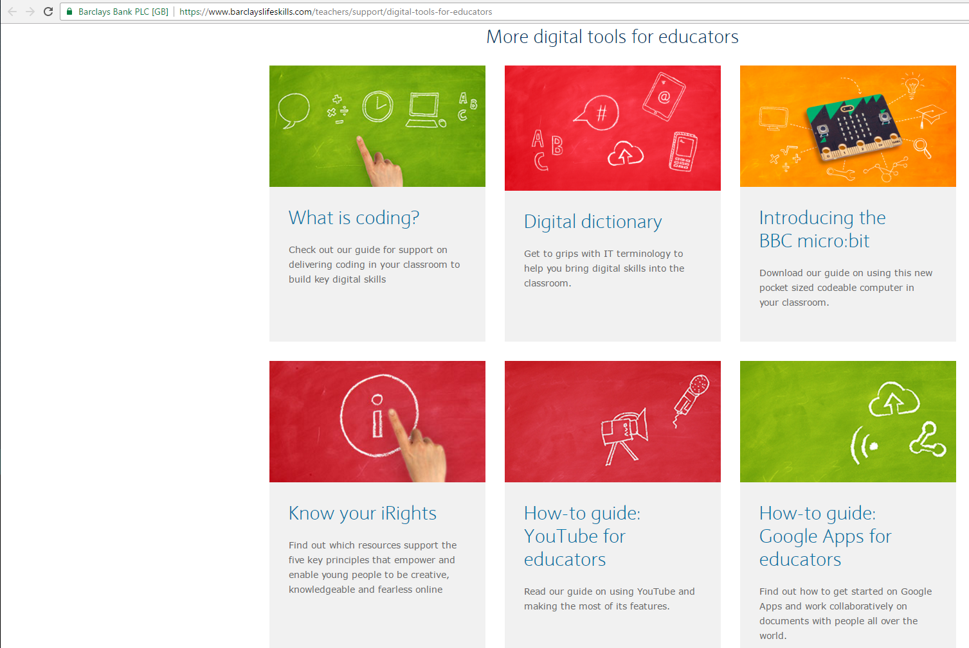

Slide 22
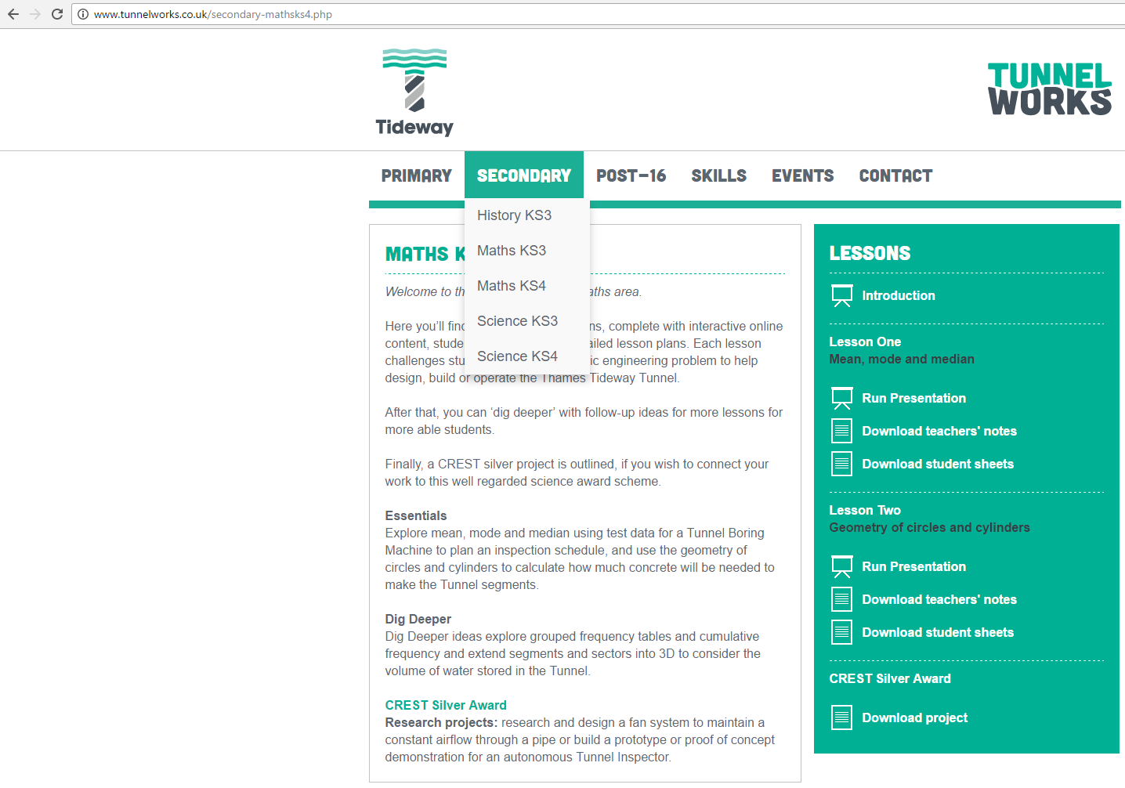

Slide 23
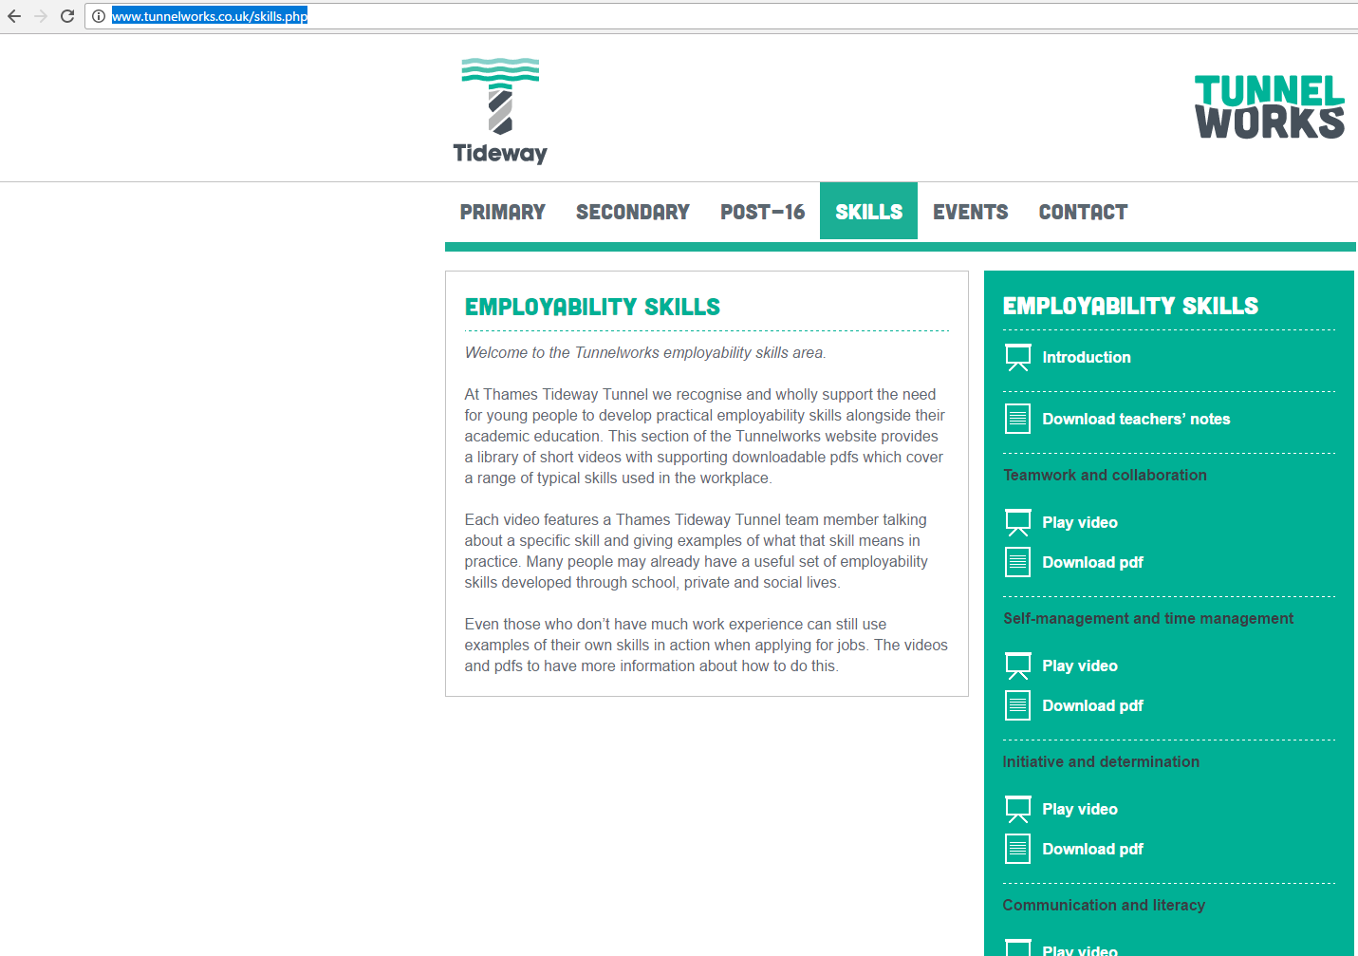

Slide 24

Modern Foreign Languages
Jobs with ...
  https://www.brightknowledge.org/knowledge-bank/modern-languages/careers-in-modern-languages/what-can-i-do-with-a-language-degree
  https://www.prospects.ac.uk/careers-advice/what-can-i-do-with-my-degree/modern-languages
  https://successatschool.org/advice/subjects
Videos ...
  http://icould.com/stories/subject/modern-languages/
  http://tv.careersbox.co.uk/films/teaching/ (found by search for languages)

Slide 25

Performing Arts
Jobs with ...
  https://nationalcareersservice.direct.gov.uk/job-profiles/performing-arts-broadcast-and-media
  https://www.prospects.ac.uk/careers-advice/what-can-i-do-with-my-degree/performing-arts-dance-drama
  https://successatschool.org/advice/subjects
Videos ...
  http://icould.com/stories/subject/drama-and-theatre-studies/
  http://icould.com/stories/subject/music-curriculum-subject/
  http://tv.careersbox.co.uk/sector.php?sector=42
Resources
  www.creative-choices.co.uk
  https://www.halfmoon.org.uk/participate/educators/secondary-college/careers-in-theatre/

Slide 26

Visual Arts
Resources ...
  https://creativeskillset.org/who_we_help/young_creative_talent
  www.creative-choices.co.uk
Jobs with ...
  https://nationalcareersservice.direct.gov.uk/job-profiles/arts-crafts-and-design
  https://successatschool.org/careerzonesummary/1/Art-Design
  https://www.prospects.ac.uk/careers-advice/what-can-i-do-with-my-degree
Videos ...
  http://icould.com/stories/subject/art-and-design/
  http://icould.com/stories/subject/design-technology/
  http://tv.careersbox.co.uk/sector.php?sector=42

Slide 27
PE/Wellbeing/Sports/Health & Social Care
Resources ...
  http://www.hepi.ac.uk/2017/02/23/3858/ Reforming BTECs : Applied General as a Route to Higher Education
Jobs with ...
  https://nationalcareersservice.direct.gov.uk/job-profiles/sport-leisure-and-tourism
  https://nationalcareersservice.direct.gov.uk/job-profiles/medicine-and-nursing
  https://nationalcareersservice.direct.gov.uk/job-profiles/social-services
  https://www.prospects.ac.uk/careers-advice/what-can-i-do-with-my-degree
  https://successatschool.org/advicedetails/562/Why-Study-Physical-Education-PE-%3F
Videos ...
  http://icould.com/stories/subject/sports-science-and-pe/
  http://icould.com/stories/subject/health-and-social-care/
  http://tv.careersbox.co.uk/sector.php?sector=43

Slide 28
IT/Business Studies/Psychology
Resources ...
  www.barclayslifeskills.com/teachers/support/digital-tools-for-educators
Jobs with ...
  https://nationalcareersservice.direct.gov.uk/job-profiles/administrative-and-clerical
  https://nationalcareersservice.direct.gov.uk/job-profiles/information-technology-and-information-management
  https://nationalcareersservice.direct.gov.uk/job-profiles/social-services
  https://www.prospects.ac.uk/careers-advice/what-can-i-do-with-my-degree
  https://successatschool.org/advice/subjects
Videos ...
  http://icould.com/stories/subject/computing/
  http://icould.com/stories/subject/business-studies-and-economics/
  http://icould.com/stories/subject/psychology/

Slide 29
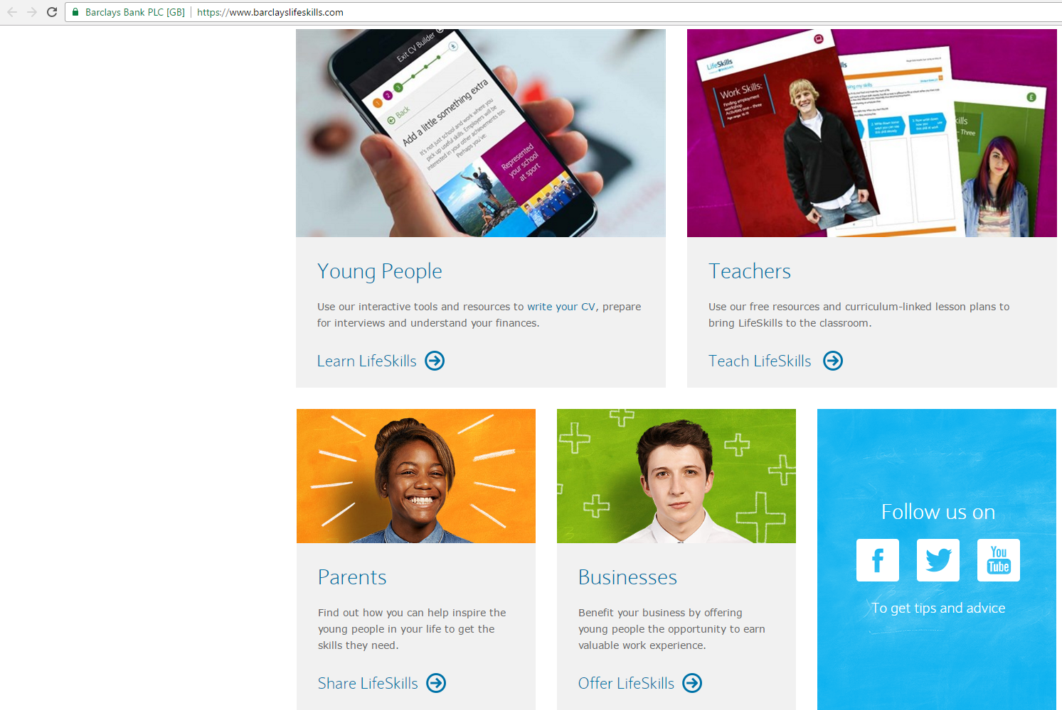

Slide 30


Humanities
Resources
  http://www.tunnelworks.co.uk/ (History)
  www.globalgeneration.org.uk/ - primarily Kings Cross area
Jobs with ...
  https://nationalcareersservice.direct.gov.uk/job-profiles/social-services
  https://nationalcareersservice.direct.gov.uk/job-profiles/environmental-sciences
  https://www.prospects.ac.uk/careers-advice/what-can-i-do-with-my-degree
  https://www.rgs.org/NR/rdonlyres/F555626F-47D0-4331-A38B-30867D1AFE6D/0/CareerseducationRGSsite.pdf (Geography)
  https://successatschool.org/advice/subjects
Videos ...
  http://icould.com/stories/subject/geography/
  http://icould.com/stories/subject/history/
  http://icould.com/stories/subject/sociology/
  http://icould.com/stories/subject/religious-studies/

Slide 31
Next Steps:
What are the immediate gaps in provision that you can recognise from a faculty point of view? What ideas do you have to develop further your subject’s contribution to pupils’ career and employability learning?

Slide 32
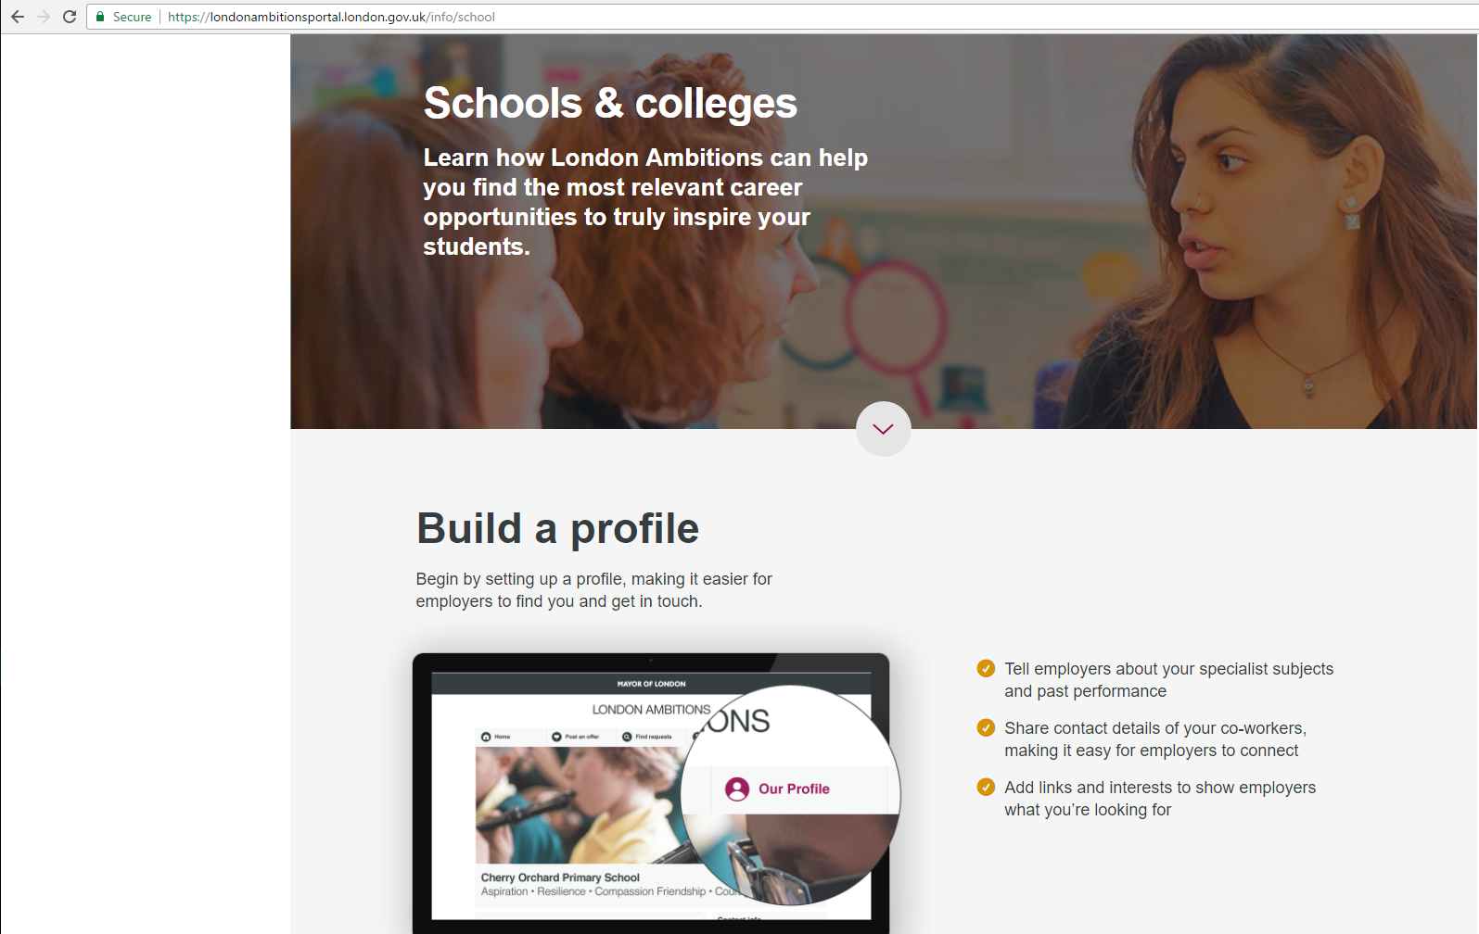

Slide 33
Support from the school’s careers leader?

