Slide 1

Annual General Meeting 2025
Weds 22nd Oct – 7.00 – 8.00pm
Chair: Ailsa Wakley

Slide 2
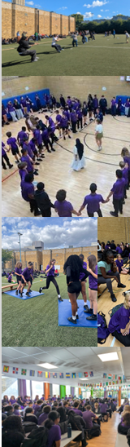
Housekeeping
Welcome!
Please ensure you are on mute
There will be Q&A at the end of the presentation if there is anything you would like to ask
The presentation will be recorded for our records

Slide 3
Agenda
Apologies for Absence
Friends of The Norwood School
  Team 2024-2025
  Charity Trustees
Chair’s Report for 2024/2025
Current PTA events Treasurer’s Report and Financial Overview
Volunteering Opportunities
What we have funded last school year and asks for this year
Other PTA activities
PTA Team Election
Q&A
Any other business
Close

Slide 4
Agenda
Apologies for Absence
Friends of The Norwood School
  Team 2024-2025
  Charity Trustees
Chair’s Report for 2024/2025
Current PTA events Treasurer’s Report and Financial Overview
Volunteering Opportunities
What we have funded last school year and asks for this year
Other PTA activities
PTA Team Election
Q&A
Any other business
Close

Slide 5
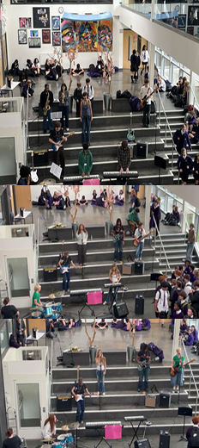
Friends of The Norwood School
Although we refer to ourselves as the PTA, we are actually a ‘Friends of’ set up. This means everyone associated with the school is included; parents, carers, family members, staff and ex-students
You are a FONS member just by having a child at the school!
FONS is a registered charity and we have a formal constitution in place which governs how we work and what we can/can’t fund.
We work with the school to raise funds to support experiences and opportunities for learning and discovery to benefit as many children as possible.
FONS is an excellent way to bring staff, parents and friends together socially whilst working towards a common goal.
Our fundraising efforts include:
  Supporting existing regular school events with our bar drinks and snacks
  Creating new events and opportunities for parents to get to know each other
  Applying for charity grants and funding

Slide 6
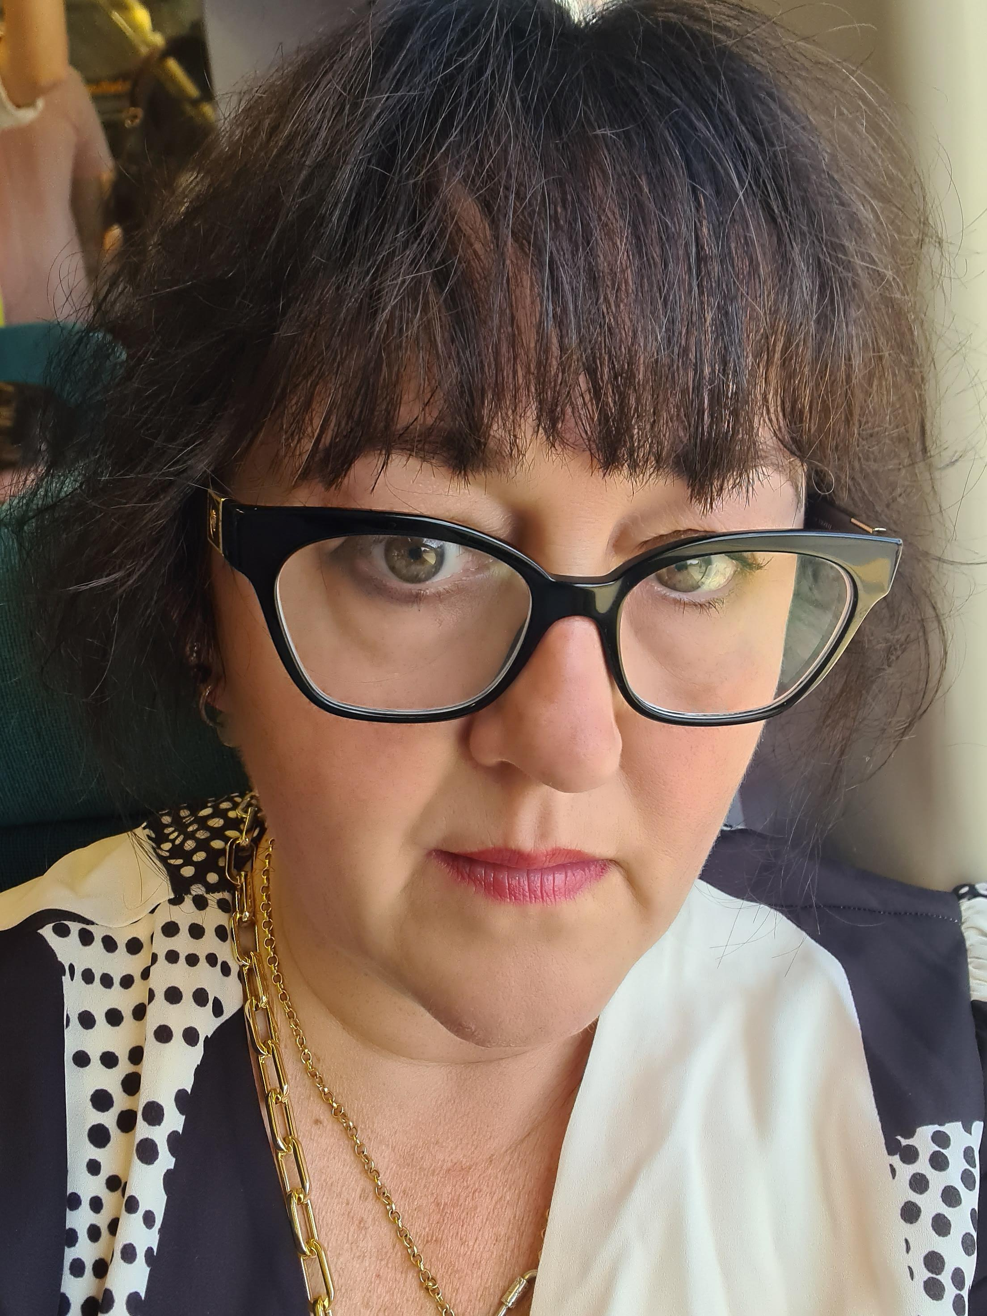
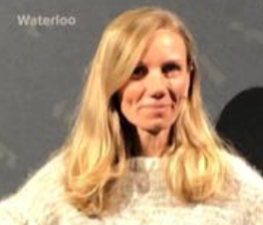
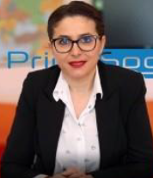
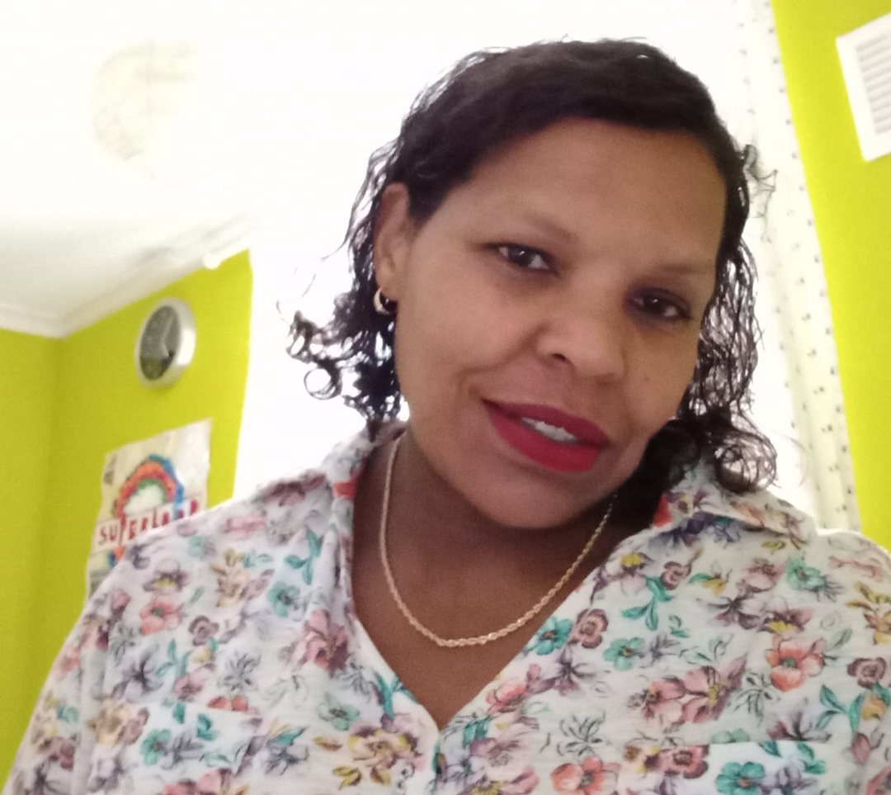
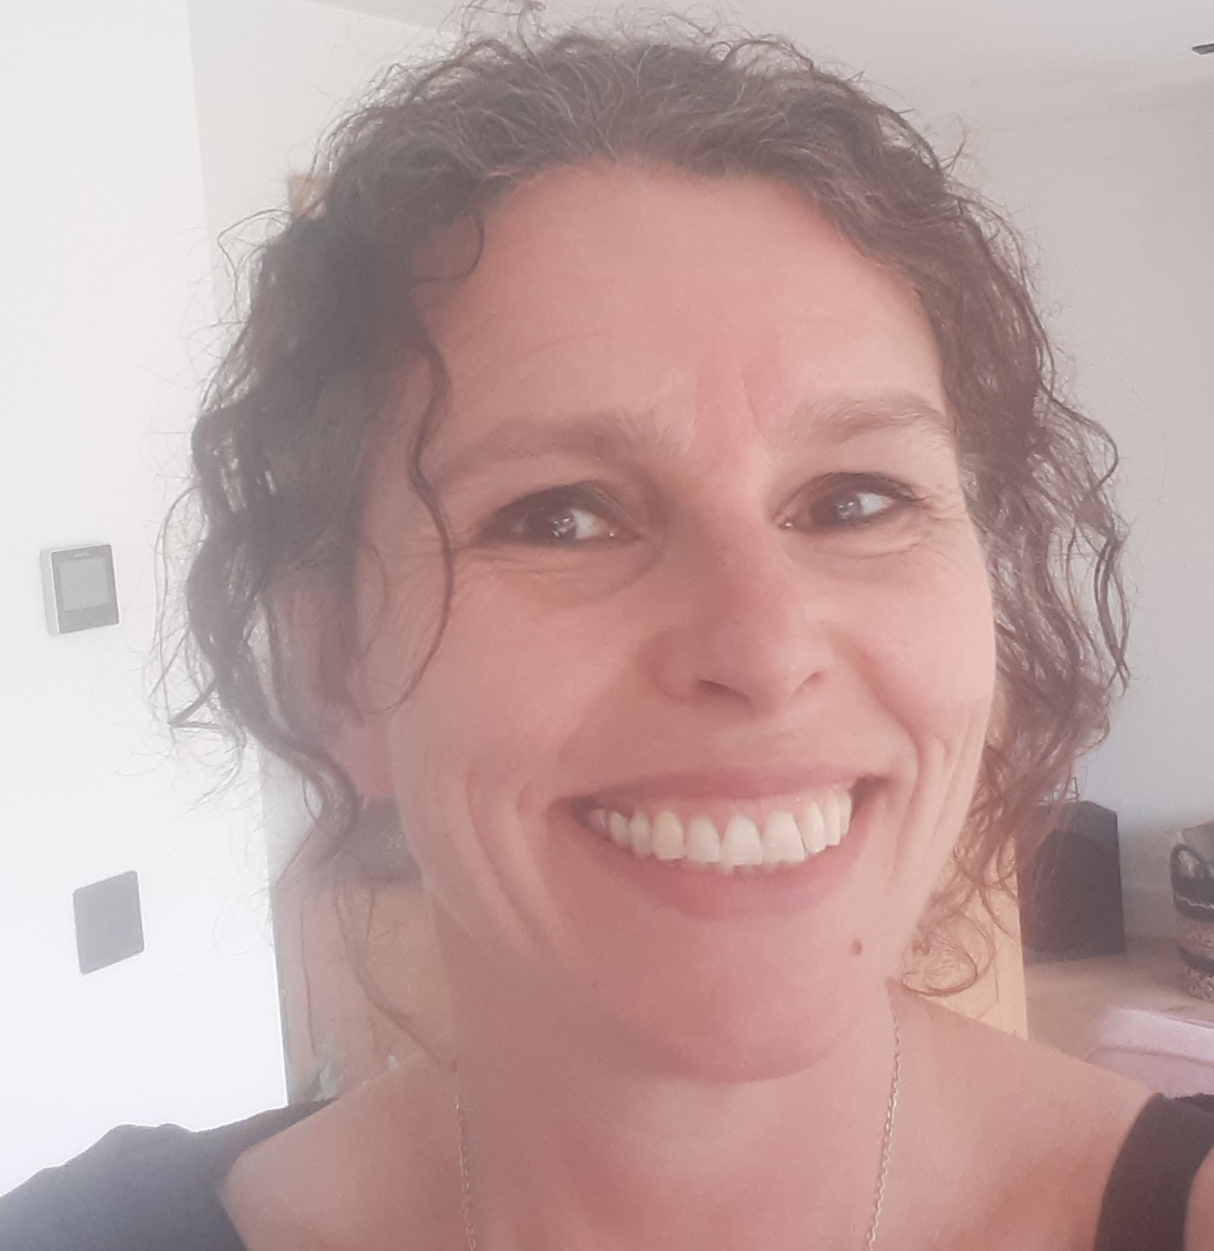
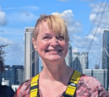
The team 2024-2025
Chair
Executive Committee
Ailsa Wakley
Treasurer
Executive Committee
Alex Brind
Secretary
Executive Committee
Bar Team
79 amazing members often co-ordinated by Meri Bilali
Uniform
Debra John
Assisted by PTA helpers
Charity Grants & Estate Agents
Miranda Bradley
Norwood School Main Contacts
Jessie Nicholas – Deputy Head
Jim Donoghue – Facilities
Reception Team
Finance - Obe
Charity Grants
Rachel

Slide 7
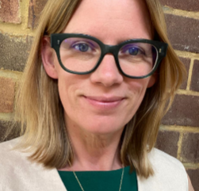
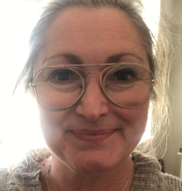

Who left us this year?
Our Charity Trustees 2024-2025
Alex Brind
Ailsa Wakley
Miranda Bradley
Co-chair
Andrea Bigger
Emma Morrison

Slide 8
Agenda
Apologies for Absence
Friends of The Norwood School
  Team 2024-2025
  Charity Trustees
Chair’s Report for 2024/2025
Current PTA events Treasurer’s Report and Financial Overview
Volunteering Opportunities
What we have funded last school year and asks for this year
Other PTA activities
PTA Team Election
Q&A
Any other business
Close

Slide 9
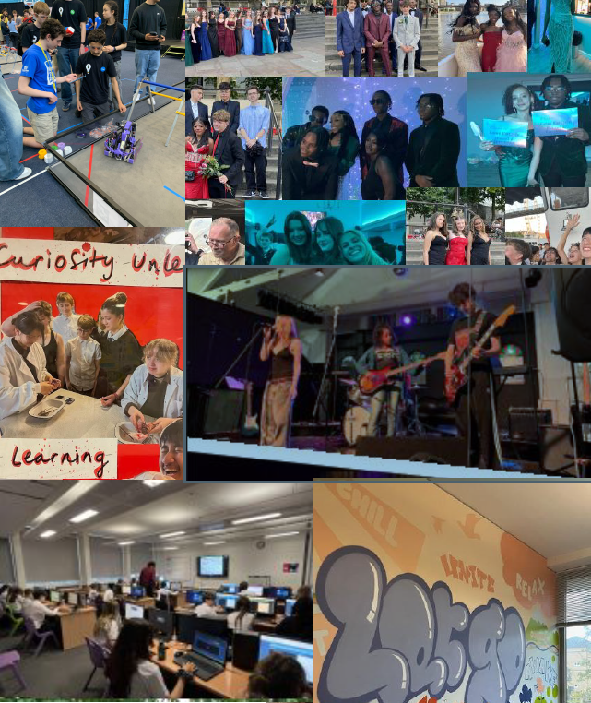
Chair’s Report

Slide 10
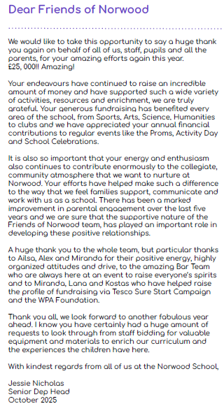
Letter from the School

Slide 11
Agenda
Apologies for Absence
Friends of The Norwood School
  Team 2024-2025
  Charity Trustees
Chair’s Report for 2024/2025
Current PTA events
Treasurer’s Report and Financial Overview
Volunteering Opportunities
What we have funded last school year and asks for this year
Other PTA activities
PTA Team Election
Q&A
Any other business
Close

Slide 12




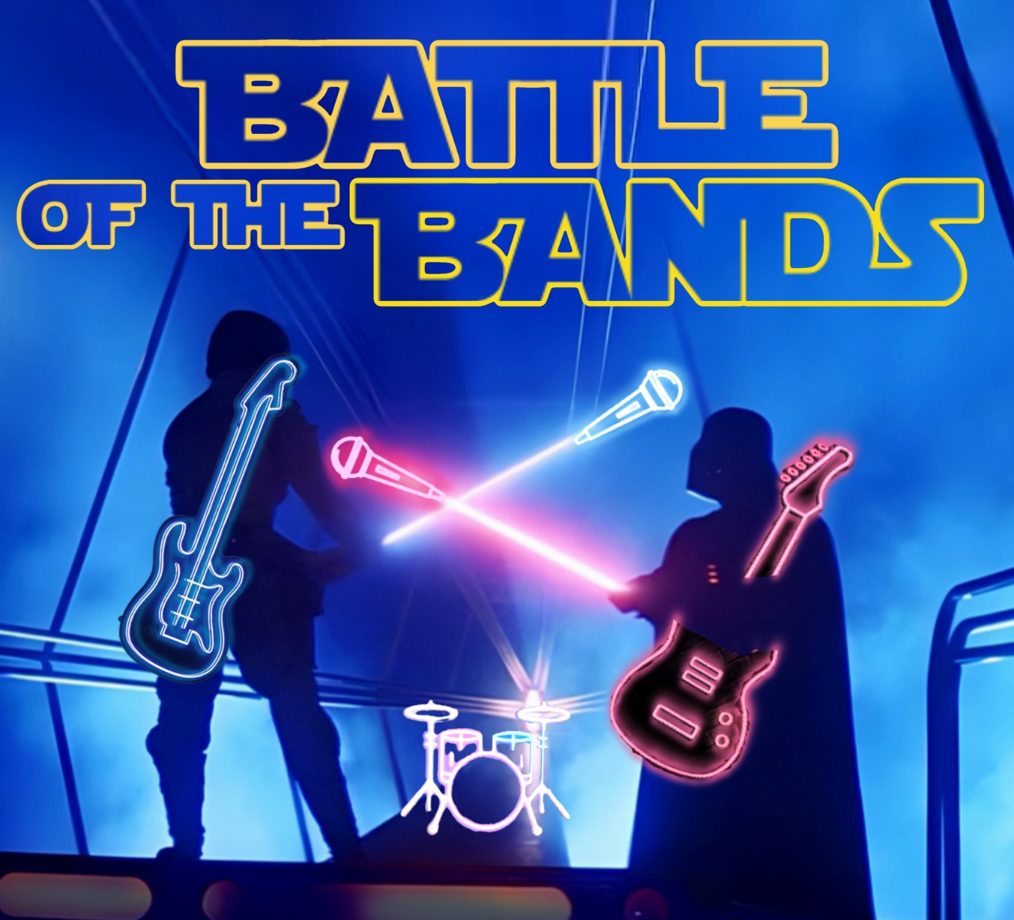







Current PTA events
Norwood’s Got Talent Christmas
Bar, stock & staffing
Christmas Fair
December
Refreshments, stalls, Christmas trees & staffing
Music Showcase
X 3 (every term)
Bar, stock & staffing
Comedy Night
Jan/Feb
Bar, stock, staffing & talent!
Battle of The Bands
Summer Term 1
Bar, stock, and staffing
So you think you can dance
Summer Term 2
Bar, stock, and staffing
Estate Agents Boards
Dec/Jan & Apr/May
Liaise with estate agents & parents
Secondhand Uniform
With a new system coming in November 2025!
We Support
Thankyou for supporting our fundraising events
Performing Arts Awards
Summer Term 2
Kid’s bar, stock and staffing
Macmillan Coffee ‘Morning’ Sept/Oct
Tea, coffee, cake & staffing
Optional
Quiz, Hot chocolate Friday’s

Slide 13
Agenda
Apologies for Absence
Friends of The Norwood School
  Team 2024-2025
  Charity Trustees
Chair’s Report for 2024/2025
Current PTA events
Treasurer’s Report and Financial Overview
Volunteering Opportunities
What we have funded last school year and asks for this year
Other PTA activities
PTA Team Election
Q&A
Any other business
Close

Slide 14
Treasurer’s Report
Our accounting year aligns with the academic year. Last accounting year: 1st August 2024 to 31st July 2025
The opening balance of the PTA’s bank account at the beginning of last accounting year: £16,088 (1st Aug 2024)
The closing balance of the PTA's bank account at the end of last academic year: £6,452 (31st Jul 2025)
Current balance 22nd October 2025: £2,227
The total amount of money raised over last academic year and a breakdown of the funds generated from each individual activity or event: £22,643

Slide 15
Treasurer’s Report
FUNDS RAISED - £22,643
COST OF DOING BUSINESS - £6201
Easyfundraising/Misc - £301
Estate Agent Boards - £2,400
Newsletter Advertising - £130
Tap devices (Bar sales/Uniform/Misc) - £10,397
Ticket Sales (Comedy Night) - £9,415
Cost of Sales (Drinks, Food, Licences) - £4,988
Accounting Software - £394
Storage/Serving Equipment - £657
Parentkind Subscription - £162
(inc PTA Insurance)
2024 – 2025 we donated more than we raised in the year due to funds in the account from the previous year.
For financial oversight, the final accounts are sent to an external accountant (parent at the school) plus the SLT ( Jessie Nicholas, Niki Clemenger and Richard Cole).
Accounts are submitted to the Charity Commission annually.

Slide 16
Agenda
Apologies for Absence
Friends of The Norwood School
  Team 2024-2025
  Charity Trustees
Chair’s Report for 2024/2025
Current PTA events
Treasurer’s Report and Financial Overview
Volunteering Opportunities
What we have funded last school year and asks for this year
Other PTA activities
PTA Team Election
Q&A
Any other business
Close

Slide 17
Volunteering Opportunities
Coming up…we will be holding elections at the end of the meeting
At the AGM all committee members stand down to be re-elected
Existing committee members can stand again
You can put yourself forward for roles
Roles can be shared

Slide 18
Volunteering Opportunities
WE ARE RECRUITING!
Co-Treasurer
Alex is looking for someone to share the role this year and is intending to stand down by end June 2026
Vice-Chair
Ailsa is keen to recruit a Vice-chair to support her in the Chair role this year and is intending to stand down by end June 2026
Bar Team Lead
Our bar events team is fantastic, but we’d love someone to coordinate volunteers and lead the team at events
Bar Stock & Purchasing Manager
We are seeking a volunteer to assist the Bar Team by ensuring the shed is fully stocked and organised prior to each event.
Comms Co-ordinator
We would like to recruit someone to focus on this as their core role – Co-ordinating the WhatsApp groups, newsletter, facebook, posters etc
Secondhand Uniform Co-ordinator
We’re looking for a coordinator for our second-hand uniform scheme, keeping it organised so families can access uniform all year-round
Estate Agent Boards
Co-ordinator
We have someone in this role, but are looking to recruit someone to take over this year. It is a great intro role that makes good money!!
Charity & Grants Manager
We would like to recruit someone to focus on additional funding, CSR from corporates etc
Would anyone like to put themselves forward today? We will revisit this in 10 minutes so have a think!

Slide 19
Agenda
Apologies for Absence
Friends of The Norwood School
  Team 2024-2025
  Charity Trustees
Chair’s Report for 2024/2025
Current PTA events
Treasurer’s Report and Financial Overview
Volunteering Opportunities
How we spend the money!
  What we are funding this year
  Big Asks
Other PTA activities
PTA Team Election
Q&A
Any other business
Close

Slide 20
How we spend the money!
Each September we send RFF (Request for Funding) forms to the school to be circulated to all staff
Every member of staff can make a request to aid their department, no request is too big or too small!
The forms are returned to the FONS committee end of September and are evaluated against our constitution
2024-2025 we funded all but one project (too niche, too expensive)
We then notify staff if their bid is approved or declined (and why), or get more detail, or in some cases just help with ideas as to how to get more funding eg STEM Robotics Team
This year we have already funded a few projects from money in the bank account but most funding starts post Christmas after we have events in November and December.

Slide 21

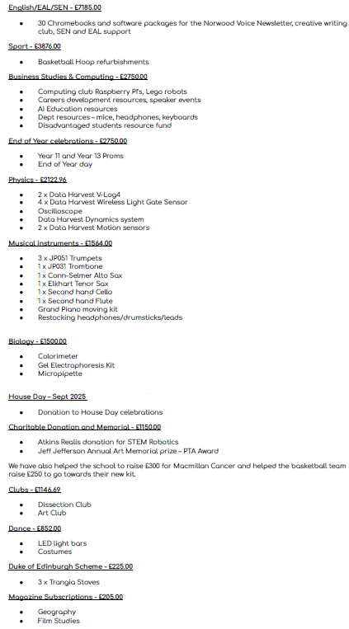

Slide 22
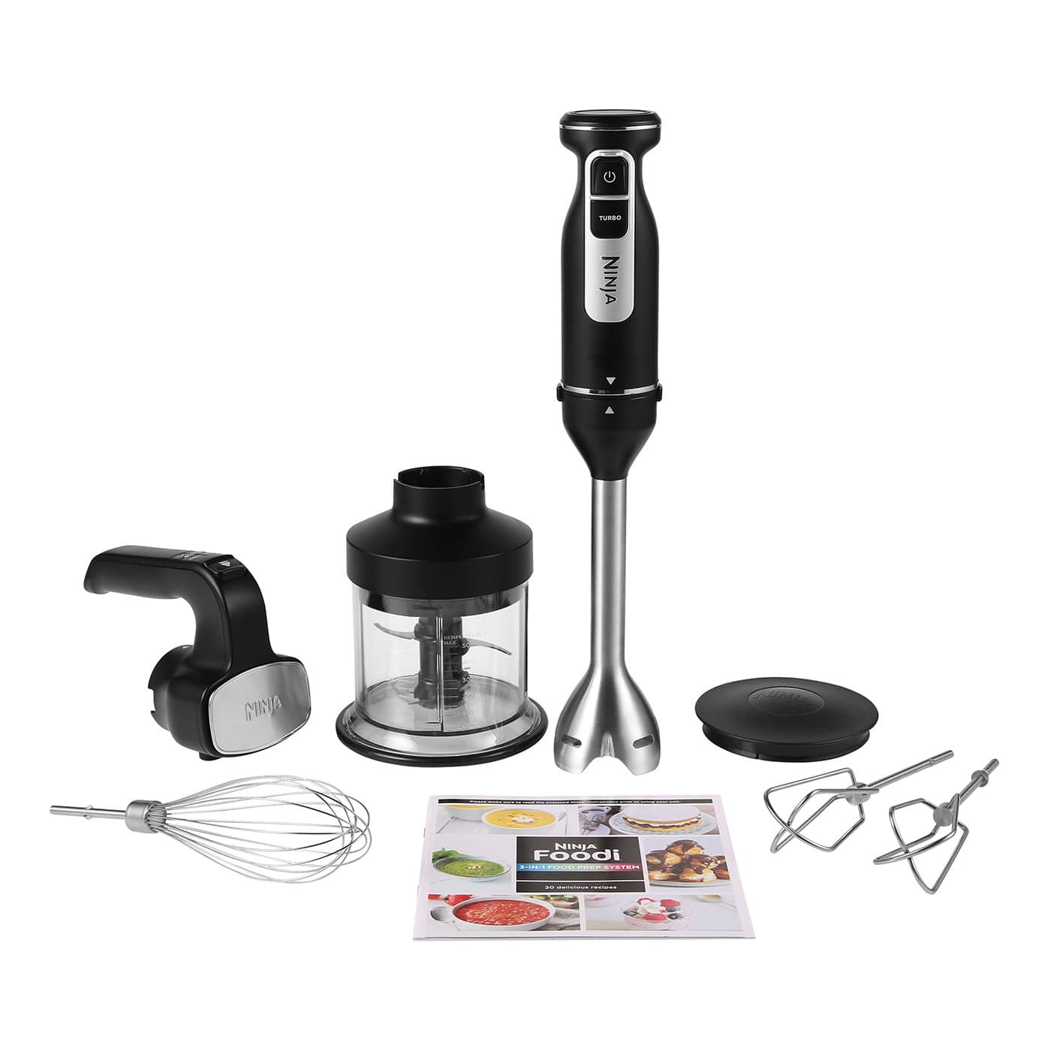
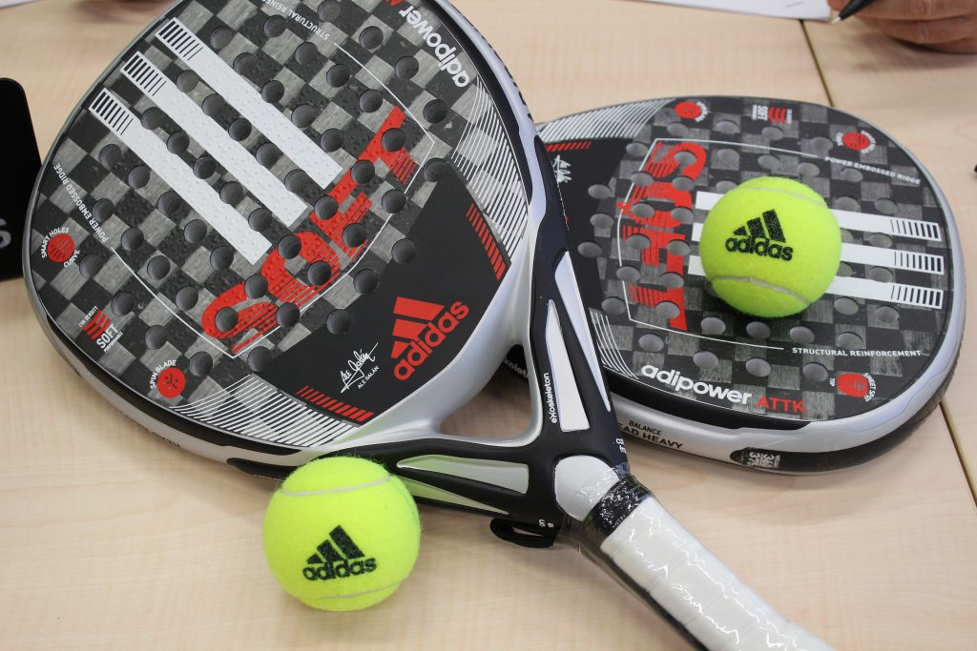
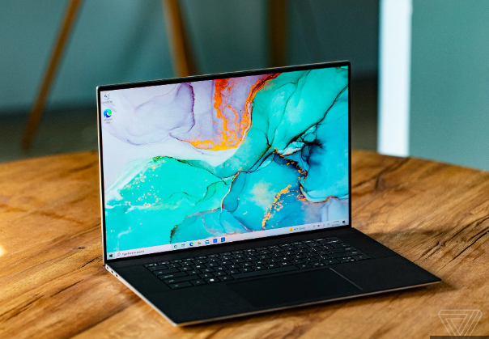
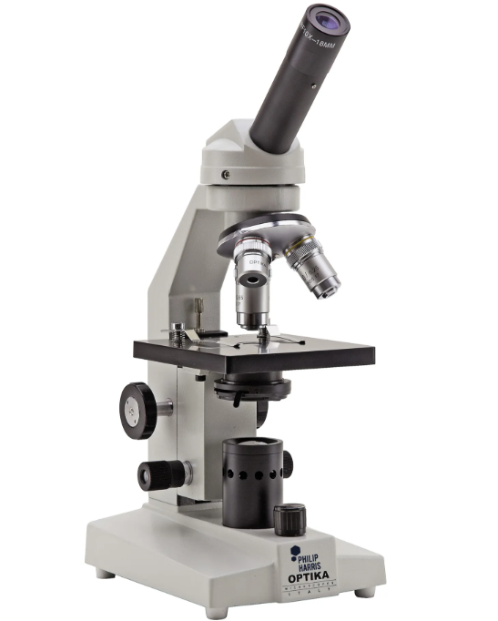
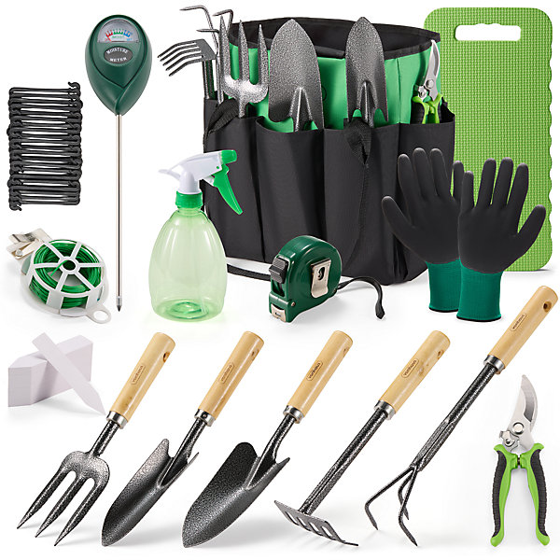
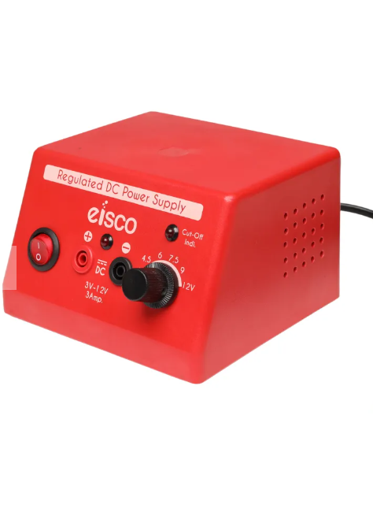

What we are looking to fund this year
We have asked all departments for their wish list! Here are some of the asks:
PICKLEBALL TENNIS AND SPORTS EQUIPMENT
FOOD TECH EQUIPMENT UPDATES
MORE SEN AND VISUAL ARTS LAPTOPS!
SCIENCE KIT FOR THE LABS
MORE CAMERAS, A SCANNER, ADDITIONAL TEXTILES AND
ART RESOURCES
MORE GARDENING EQUIPMENT
Some have been funded already eg Pickleball, the scanner and food tech.
We already have an ongoing commitment to fund annual costs (£4500) eg Yr 11 and 13 Proms, subscriptions and school days out and our ongoing costs to run FONS – bar stock, admin costs like tap devices, insurance etc

Slide 23
The Big Asks
Air Conditioning for the dance studios - £8000+
  Essentially a Cap Ex expense for the school more than FONS responsibility – outside of Constitution
  Waiting on a full quote
  Possible to purchase free-standing but is that effective?
New seating for the Theatre - £15,000+
  It’s a lot of money and probably more than £15,000
  But if 350 people bought a seat each it is £43 per seat
  May allow the school to rent out the space more easily and generate their own funding

Slide 24
Agenda
Apologies for Absence
Friends of The Norwood School
  Team 2024-2025
  Charity Trustees
Chair’s Report for 2024/2025
Current PTA events
Treasurer’s Report and Financial Overview
Volunteering Opportunities
How we spend the money!
  What we are funding this year
  Big Asks
Other PTA activities
PTA Team Election
Q&A
Any other business
Close

Slide 25







Other PTA Activities & Support
School Newsletter
Currently weekly
Provide content &
co-ordinate advertising
WhatsApp
Currently weekly
Oversee for spam/comments
Promote activities & events to groups
Set up groups for New Year 6-7
Rename for new school year
Easy fundraising
Promote to new parents
Communicate special events
Annual school gifts
Provide financial support for clubs, proms and magazine subscriptions
Bar team stock management
Stocktaking, coordinating and buying bar/ refreshment stock for events
Jefferson art prize
provide support for awarding the Jefferson art prize in memoriam
Financial Admin
Accounts, charity commission, tap devices etc.

Slide 26
Agenda
Apologies for Absence
Friends of The Norwood School
  Team 2024-2025
  Charity Trustees
Chair’s Report for 2024/2025
Current PTA events
Treasurer’s Report and Financial Overview
Volunteering Opportunities
How we spend the money!
  What we are funding this year
  Big Asks
Other PTA activities
PTA Team Election
  Rules of engagement
  Voting
Q&A
Any other business
Close

Slide 27
PTA Team Election
We need to be quorate for voting – more than 3 additional attendees
Votes will be shown by raised hands and counted by Miranda. If you like, you can use the ‘React’ button at the bottom of your screen and select ‘Raise Hand’ or vote in the Chat.
If more than one person stands for a role, roles can be shared
FONS Committee and other volunteers from last year have now stepped down and we are putting ourselves forward for re-election.

Slide 28
Recruiting roles
WE ARE RECRUITING!
Co-Treasurer
This new role is now open. Are there any nominations?
Vice-Chair
This new role is now open. Are there any nominations?
Bar Team Lead
This role is now open. Are there any nominations?
Bar Stock & Purchasing Manager
This new role is now open. Are there any nominations?
Comms Co-ordinator
Would anyone step forward to transition the comms role from Ailsa this year?
Secondhand Uniform Co-ordinator
This role is now open. Are there any nominations?
Estate Agent Boards
Co-ordinator
Miranda is formally standing down from this role. Would anyone like to step forward to run the two board runs annually?
Charity & Grants Manager
Would anyone like to step forward to share this role with Rachel who is standing again?
Any roles left unfilled will be publicised again to all parents and carers and we’ll invite expressions of interest over the next few weeks. We have full job descriptions for all roles and these can be requested from friendsofthenorwoodschool@gmail.com

Slide 29
Agenda
Apologies for Absence
Friends of The Norwood School
  Team 2024-2025
  Charity Trustees
Chair’s Report for 2024/2025
Current PTA events
Treasurer’s Report and Financial Overview
Volunteering Opportunities
How we spend the money!
  What we are funding this year
  Big Asks
Other PTA activities
PTA Team Election
  Rules of engagement
  Voting
Q&A
Any other business
Close

Slide 30

Questions and Answers

Slide 31
Any Other Business?
Post this meeting we will follow up any roles left unfilled
The FONS page on the school website will be updated with the latest documents plus WhatsApp and newsletter messages
There will be a committee meeting for all new committee members – date TBC
FONS events coming up:
  20th November – Music Showcase
  27th November – Dance Showcase
  10th/11th/12th December date TBC - FONS Christmas Afternoon
  18th December - Norwood Factor

Slide 32

Close

